Slide 1



What we have learned from CEOS
The school experience
Pristina, 19th November 2024

Slide 2
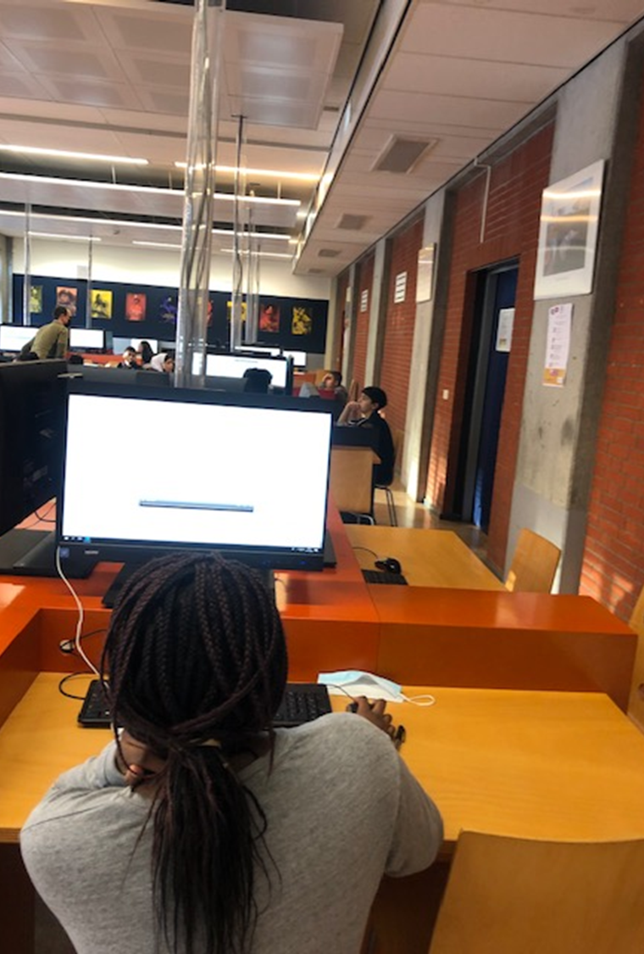






Mission Statement CEOS
..Uncover and develop unseen cognitive talents of students from disadvantaged social groups by improving their academic linguistic strategies, training their teachers and involving their parents.
Notes:
Lineke
This project wants to uncover and develop unseen cognitive talents of students from disadvantaged social groups by improving their academic linguistic strategies, training their teachers and involving their parents.

Slide 3
Goals CEOS
Identifying gifted and talented students with a low socio-economic status with a cognitive abilities test
Improving the academic language skills of cognitively talented students with a less privileged background
Notes:
Lineke

Slide 4
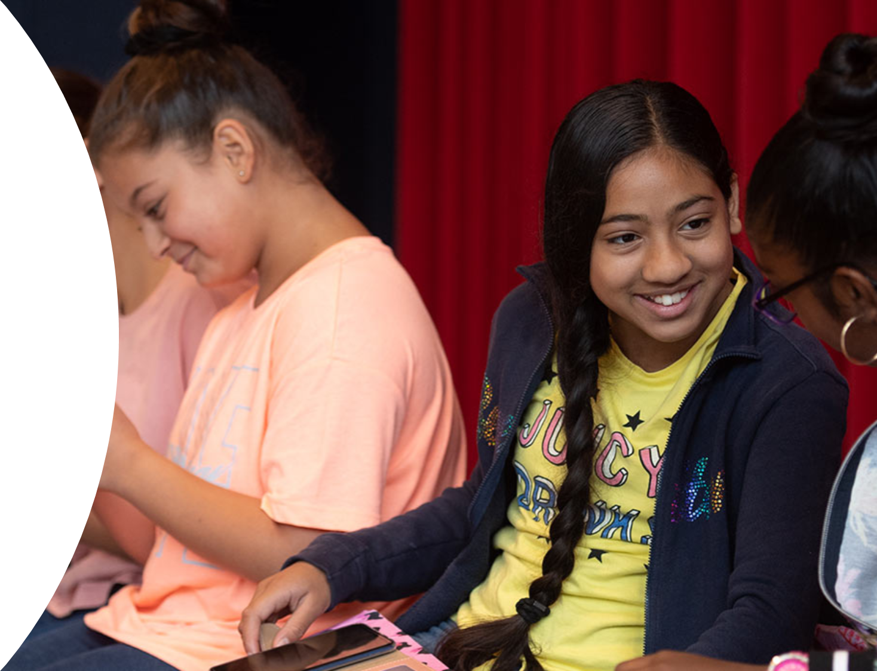
Method
1,097 first-year students screening pre-test COVAT-3
Cognitive ability test non-verbal
Four schools
Academic language programme
Two interventions in two academic years
Post-test
Notes:
Birgit

Slide 5
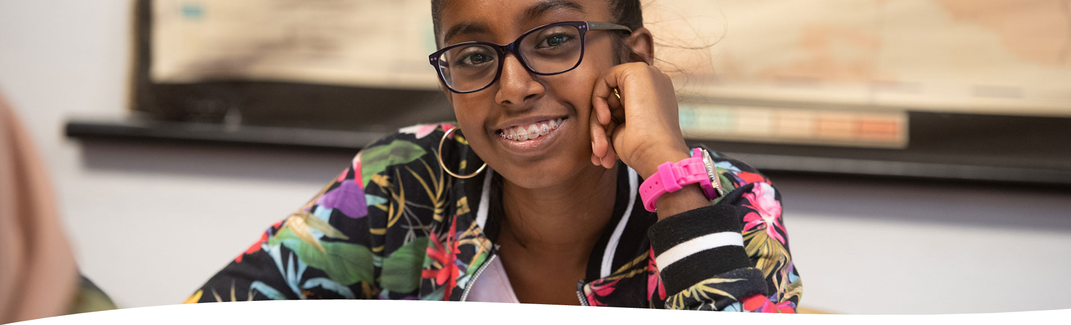
SES
The socio-economic status (SES) was based on home language, migration status, educational level mother, and profession father.
Students and parents who had at least 1 low SES indicator were considered a minority.
At two schools almost all students belonged to a minority.
Notes:
Birgit

Slide 6
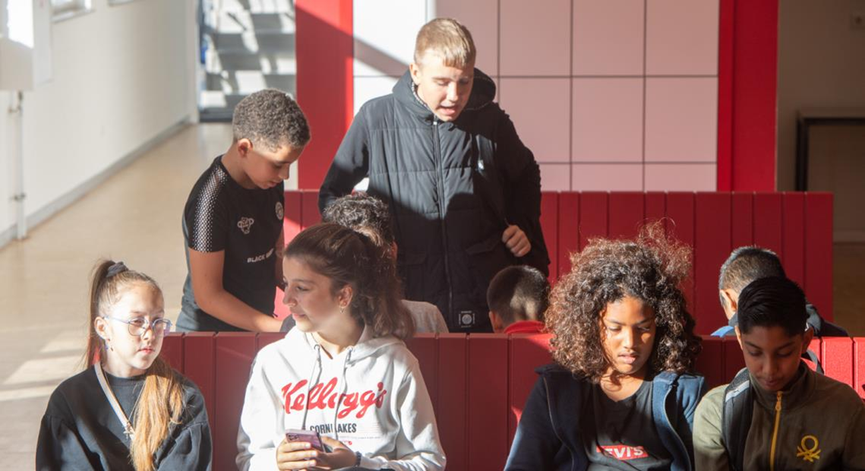
Selection CEOS project
Students with a low SES
Scores in the top 20% of the non-verbal cognitive pre-test
Cognitive talent selected for project
70 students in the programme group – intervention with academic language programme
70 students in the control group
Post-test
Questionnaire motivation
School results start and final report
Notes:
Birgit

Slide 7
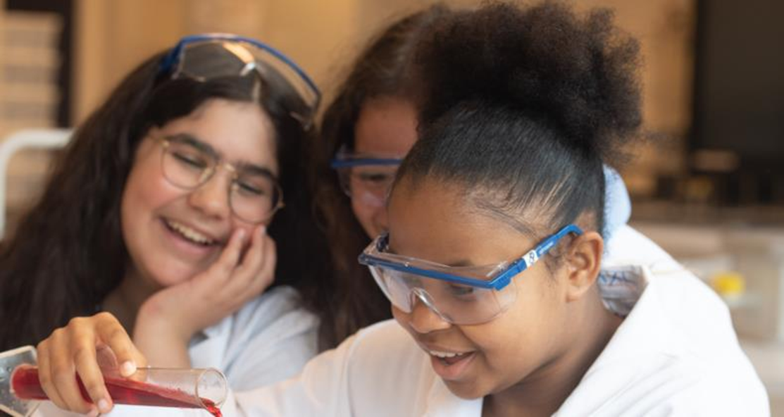
Materials
Information about SES (home language, migration status, education mother, profession father)
COVAT-3 (Magez, Van Parijs, Joris , & Tierens, in development) to identify cognitive talent
Digital version of the CoVaT CHC basis version
Notes:
Birgit

Slide 8
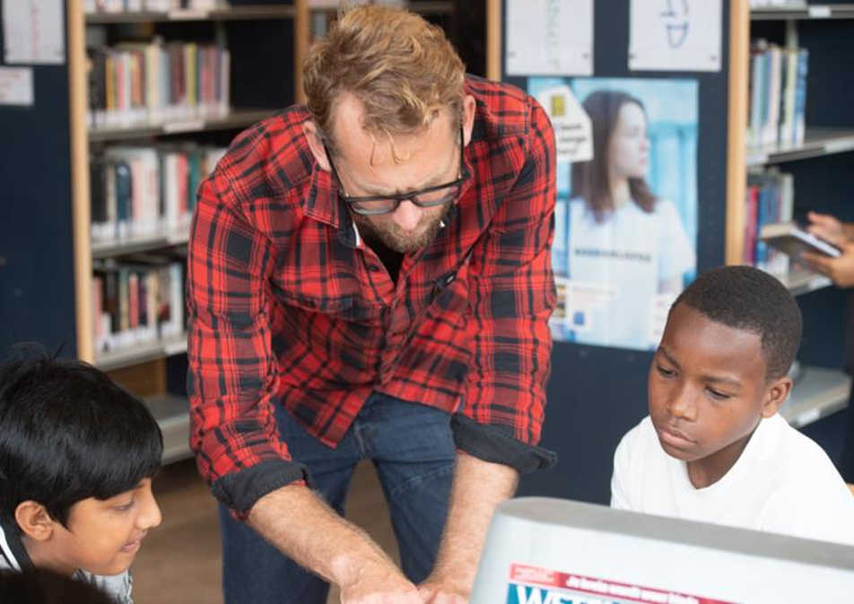
COVAT-3
Non-verbal test for fluent reasoning
Verbal test for cristallised knowledge and comprehension
Test results were not shared with students, parents, and teachers.
Notes:
Birgit

Slide 9
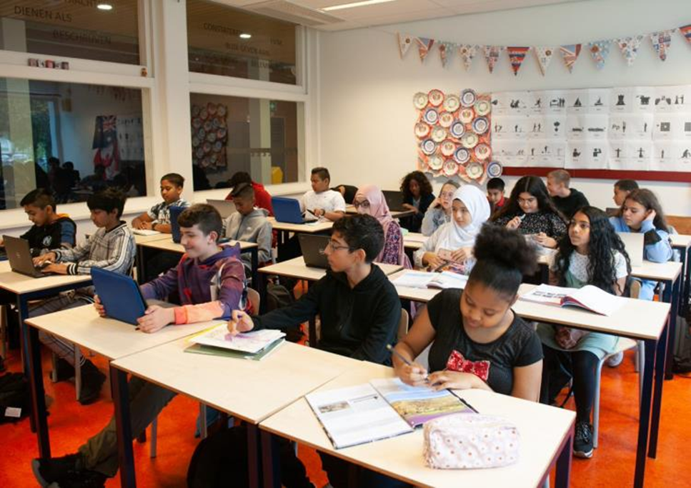
Motivation and school results
Motivation was measured with a questionnaire developed for Project TALENT (Verschueren, Sypré, Struyf, Lavrijsen, & Vansteenkiste, 2021)
Motivation, demotivation, commitment, boredom, flow, and burnout
School results of five subjects (first and final reports)
Notes:
Birgit

Slide 10
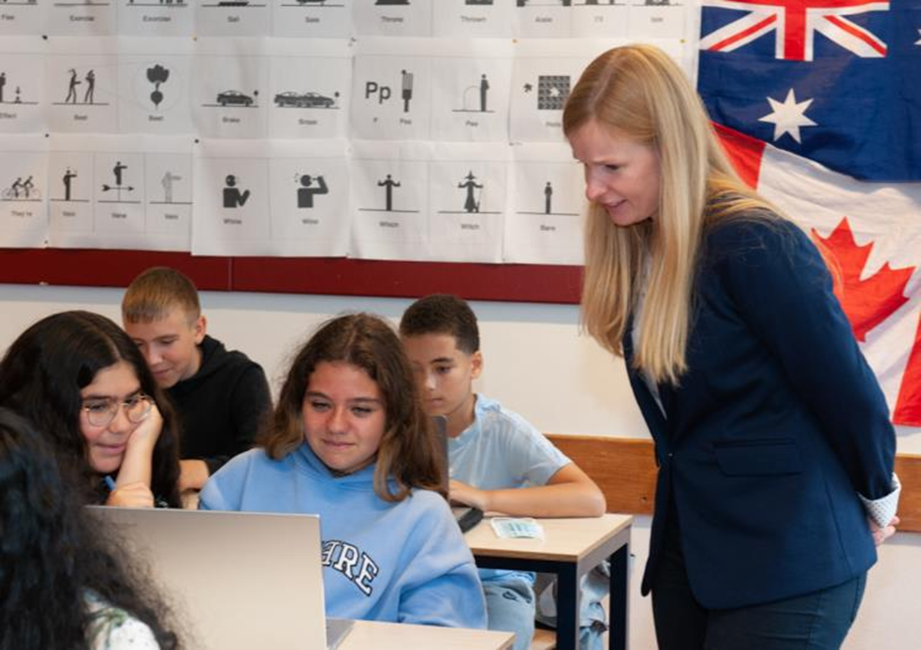
Procedure
The CEOS project was approved of by the ‘Social and Societal Ethics Committee’ of KU Leuvenin September 2019.
Information and consent letters were translated in diverse languages (French, English, Turkish, and Arabic) to inform parents and students about the project and the academic language programme as well as possible.
Development of word list and learning method by teachers and publishing institute.
Notes:
Birgit

Slide 11
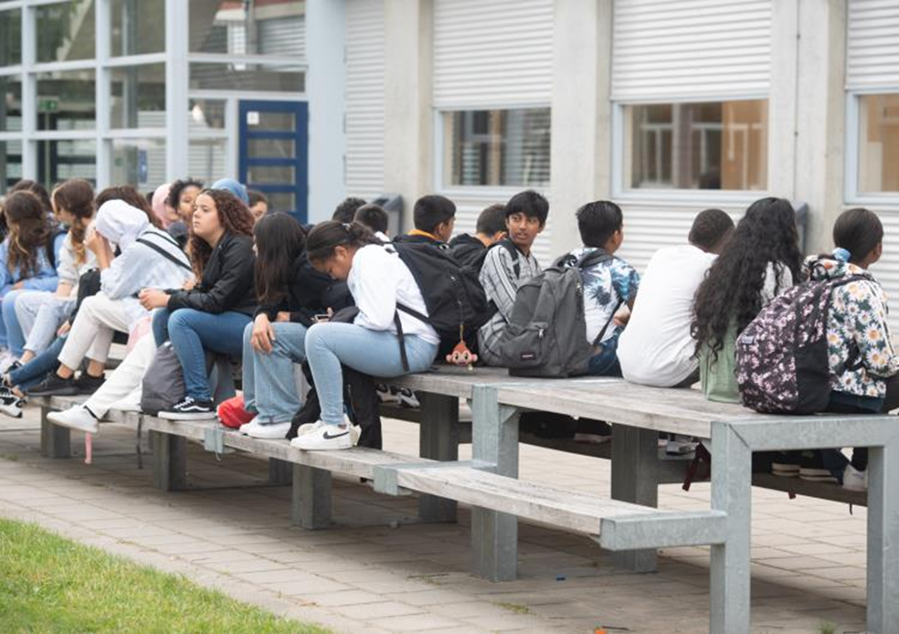
Pre-tests
Group screening at school
Supervision by teachers, a member of the research team, and students of Thomas More, Antwerp
Start of the academic year
Selection of cognitive talent with a minority background based on SES and the non-verbal part of the COVAT-3
Programme/intervention group and control group
Notes:
Birgit

Slide 12
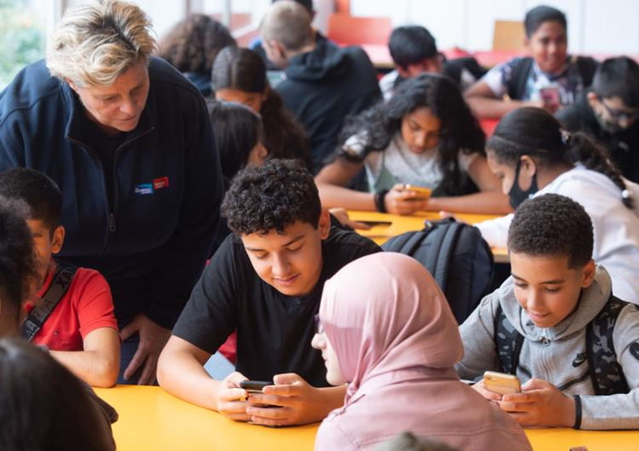
Programme/intervention and control
Intervention group got academic language programme
2 x 25 minutes
12 weeks
Extracurricular
Post-test
Notes:
Birgit

Slide 13
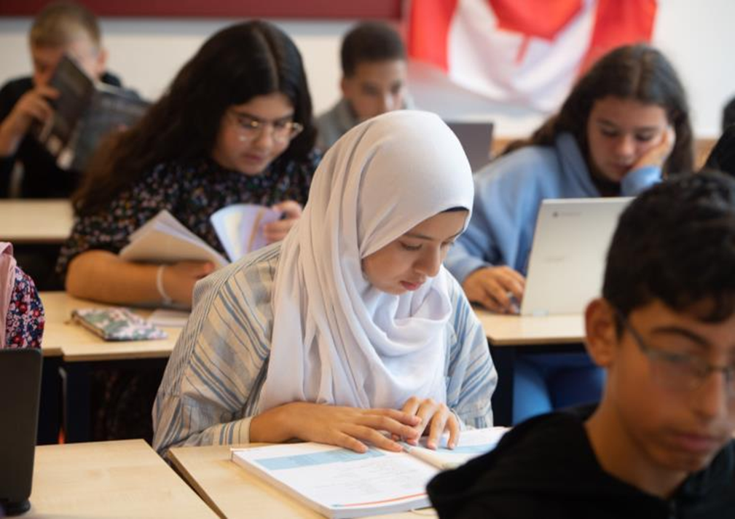
Results
Students with low SES scored significantly lower at reasoning and at the verbal test, compared to students with an average or high SES
Cognitive talent with low SES scored non-verbally and verbally in top 20%
School results improved specifically at geography, maths, and history
Motivation measurements indicated not enough yet (Covid situation – online education)
Parent participation minimal (Covid)
Notes:
Birgit

Slide 14
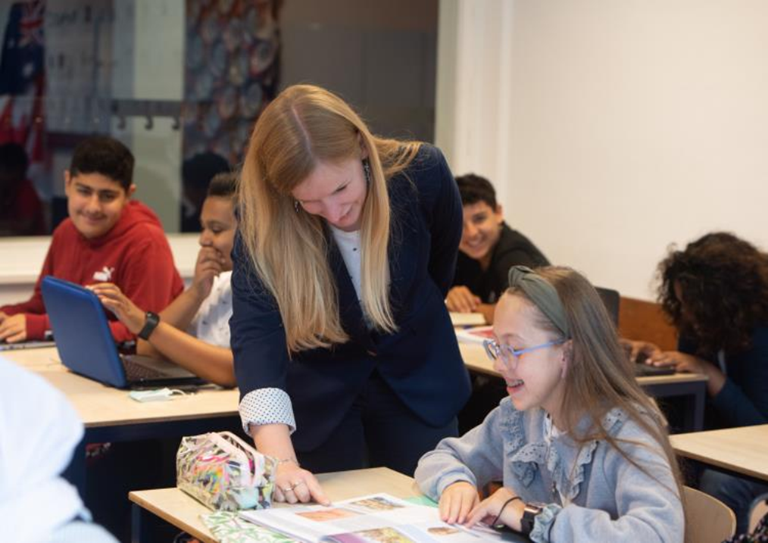
Conclusion
The CEOS project was innovative because target group is underrepresented in many educational programmes for gifted students
Hidden cognitive talent was identified with a non-verbal reasoning test
Teachers, students, and their parents know with which programme students with low SES can improve their Dutch academic language
Notes:
Birgit

Slide 15
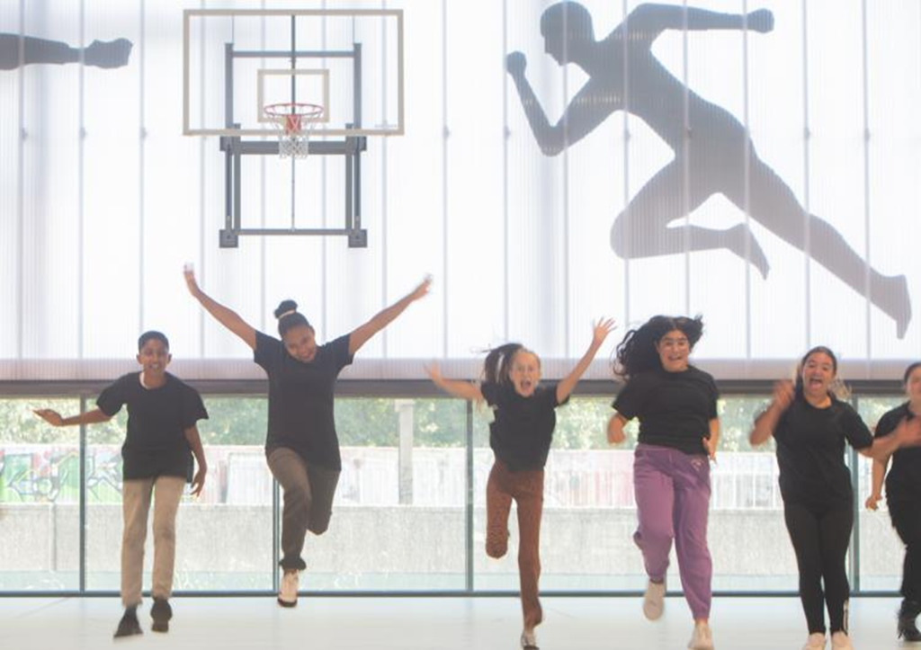
Currently
Implementation academic language programme for all first year students
1 lesson per week
Small groups (max 15)
All first year students are screened with COVAT-3
Identification hidden talent
Notes:
Birgit

Slide 16
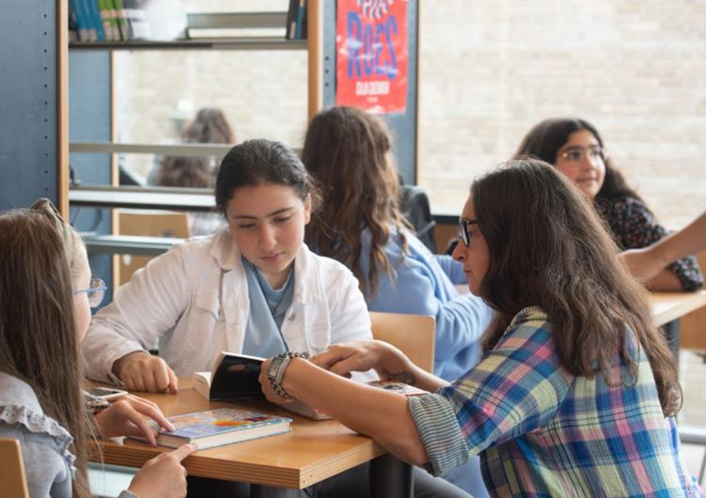
Currently
Teacher training in academic language programme
Academic research in school (effects of language programme)
Parent participation needs improvement
Optimising equal opportunities
Identification hidden talent
Notes:
Birgit

Slide 17
Literature
Benner, A., Boyle, A., & Sadler, S. (2016). Parental involvement and adolescents´educational success: The roles of prior achievement and socioeconomic status. journal of Youth and Adolescence, 1053-1064. doi:10.1007/s10964-0160431-4
Gagné, F. (2004). Transforming gifts into talents: the DMGT as a developmental theory. Hihgh Ability Studies, 15, 119-149.
Gagné, F. (2010). Motivation within the DMGT 2.0 framework. High Ability Studies, 21, 81-99. doi:10.1080/13598139.2010.525341
Heller, K. (1991). The nature and development of giftedness: a longitudinal study. European Jourbnal for High Ability, 2, 174-188.
Heller, K. (1999). Individual ( learning and motivational) needs versus instructional conditions of gifted education. High Ability Studies, 10, 9-23.
Magez, W., Van Parijs, K., Joris , S., & Tierens, M. (in development). COVAT-3: Digitale cognitieve vaardigheidstest volgens het CHC-model. Antwerpen: Psychodiagnostisch Centrum en CAPvzw.
Pfeiffer, S. I. (2015). Essentials of gifted assessment (Vol. Essentials of Psychological Assessment Series). Hoboken, NJ:Wiley.
UNICEF Office of Research. (2017). Building the future: Children and the sustainable development goals in rich countries. Innocenti Report Card 14, 1-58. Retrieved from https://www.unicef-irc.org/publications/pdf/RC14_eng.pdf
Verschueren, K., Sypré, S., Struyf, E., Lavrijsen, J., & Vansteenkiste, M. (2021). Ontwikkelen van cognitief talent: Handboek voor onderwijsprofessionals. Leuven: Acco.
Notes:
Birgit

